Slide 2

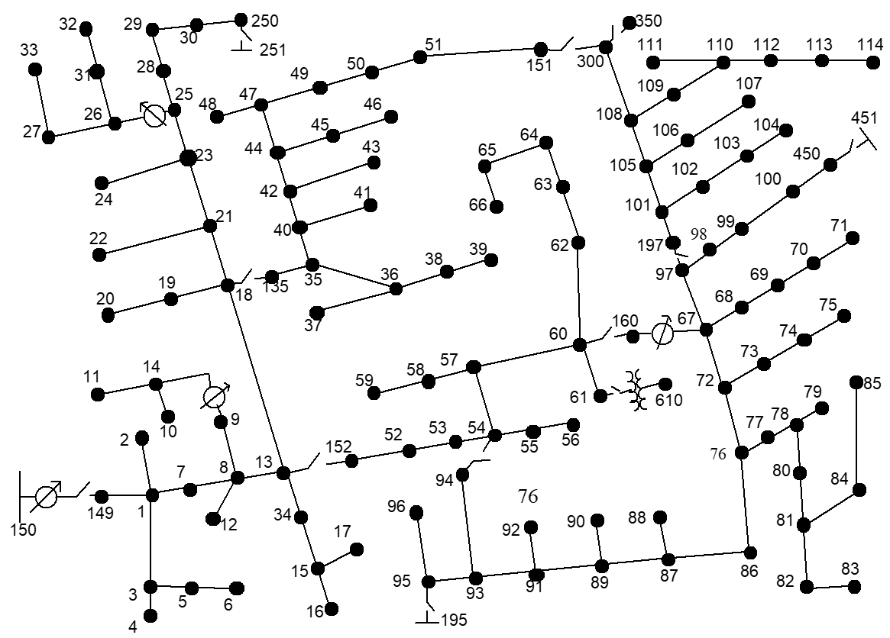
PV
Area-2
Area-1

Slide 3
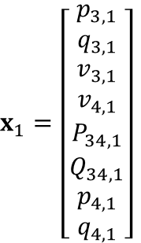
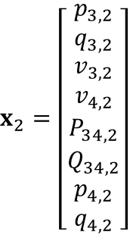
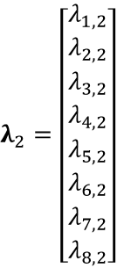
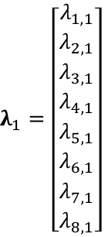
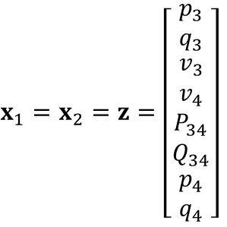
Area-2
Area-1
18-bus three-phase network
1
2
3
4
5
11
12
13
14
15
6
7
8
9
10
16
17
18
6
19
20
Area-1
3
7
8
9
13
14
1
2
15
16
17
18
10
Area-3
5
4
11
12
Area-2
$x_{1}=\left[\begin{matrix}p_{3,1} \\ q_{3,1} \\ \begin{aligned}v_{3,1} \\ v_{4,1}\end{aligned} \\ P_{34,1} \\ Q_{34,1} \\ \begin{aligned}p_{4,1} \\ q_{4,1}\end{aligned}\end{matrix}\right]$
$λ_{1}=\left[\begin{matrix}λ_{1,1} \\ λ_{2,1} \\ \begin{aligned}λ_{3,1} \\ λ_{4,1}\end{aligned} \\ λ_{5,1} \\ λ_{6,1} \\ \begin{aligned}λ_{7,1} \\ λ_{8,1}\end{aligned}\end{matrix}\right]$
$x_{1}=x_{2}=z=\left[\begin{matrix}p_{3} \\ q_{3} \\ \begin{aligned}v_{3} \\ v_{4}\end{aligned} \\ P_{34} \\ Q_{34} \\ \begin{aligned}p_{4} \\ q_{4}\end{aligned}\end{matrix}\right]$
$x_{2}=\left[\begin{matrix}p_{3,2} \\ q_{3,2} \\ \begin{aligned}v_{3,2} \\ v_{4,2}\end{aligned} \\ P_{34,2} \\ Q_{34,2} \\ \begin{aligned}p_{4,2} \\ q_{4,2}\end{aligned}\end{matrix}\right]$
$λ_{2}=\left[\begin{matrix}λ_{1,2} \\ λ_{2,2} \\ \begin{aligned}λ_{3,2} \\ λ_{4,2}\end{aligned} \\ λ_{5,2} \\ λ_{6,2} \\ \begin{aligned}λ_{7,2} \\ λ_{8,2}\end{aligned}\end{matrix}\right]$
Consensus variables between areas:
Notes:
So I started by solving on a sample 18-bus three-phase model. With linear branch flow model as the grid model, 3-phase model that considers mutual coupling.
The local boundary variables are the injection, voltage and branch flows as shown.

Slide 4
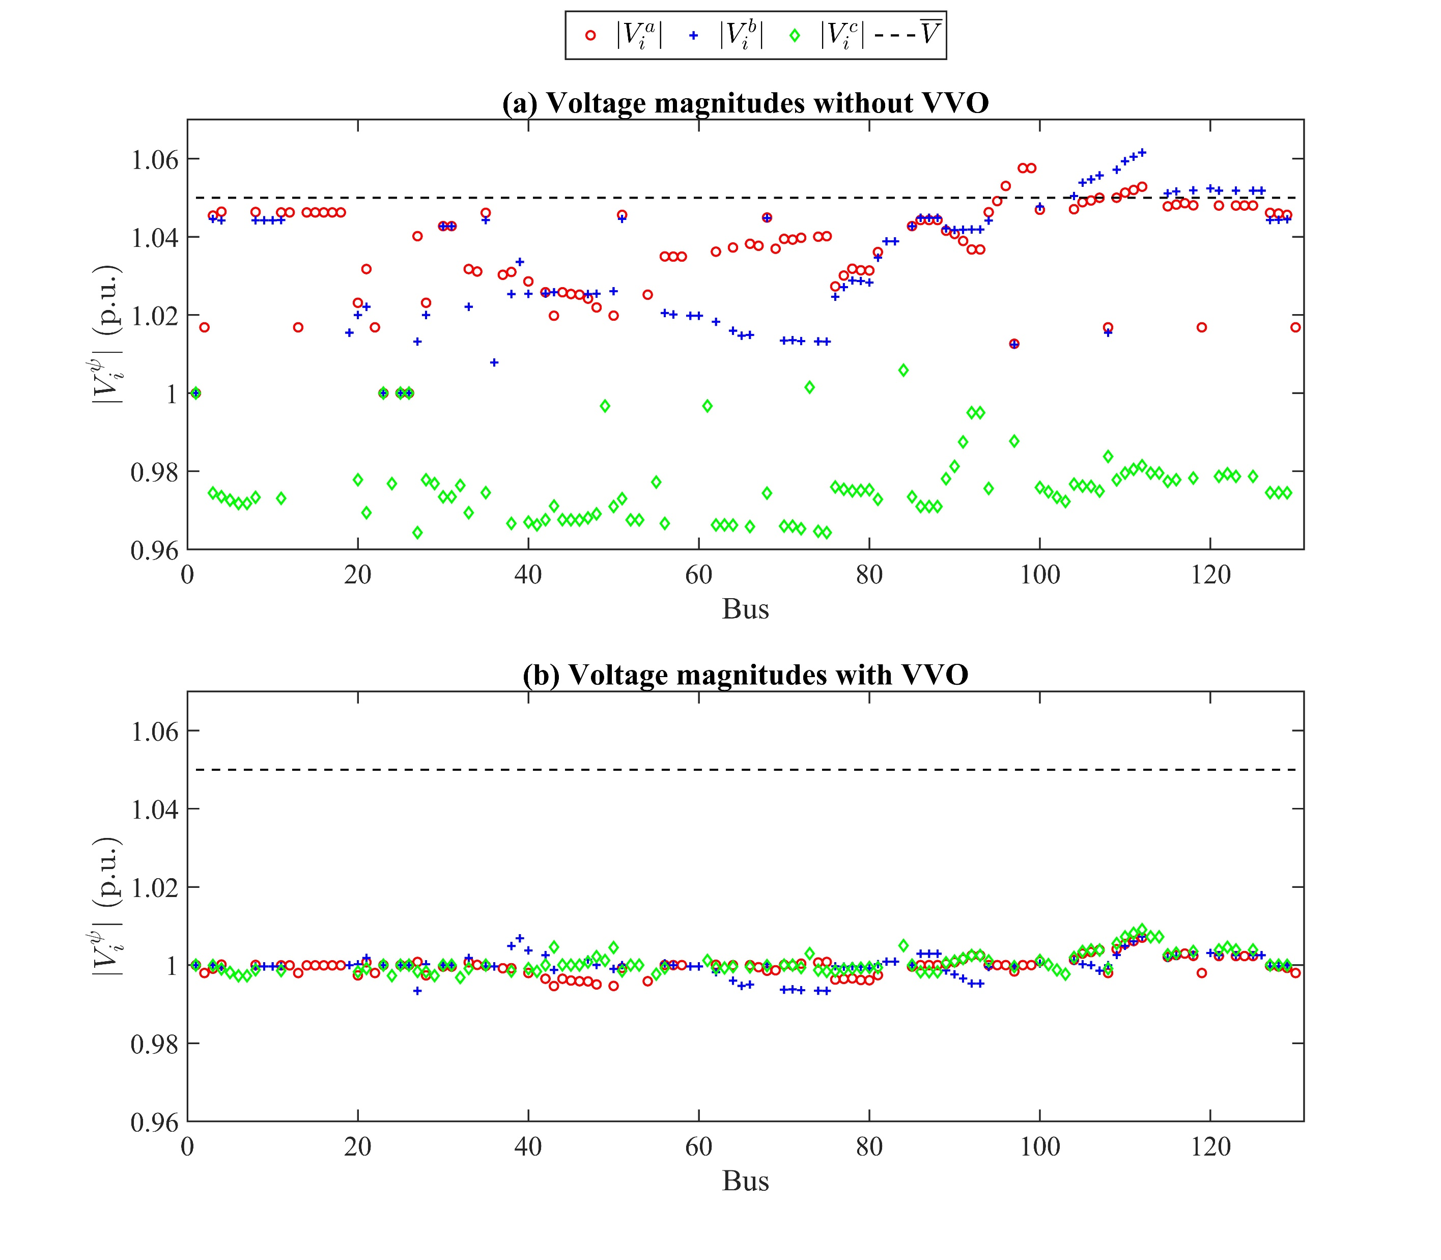

Slide 5
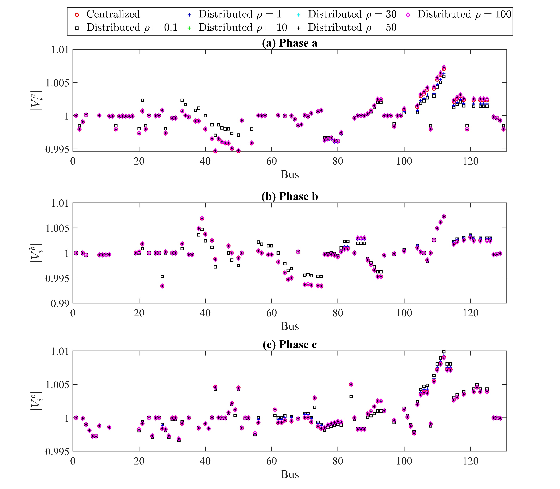

Slide 6
Centralized
Centralized
Distributed

Slide 7
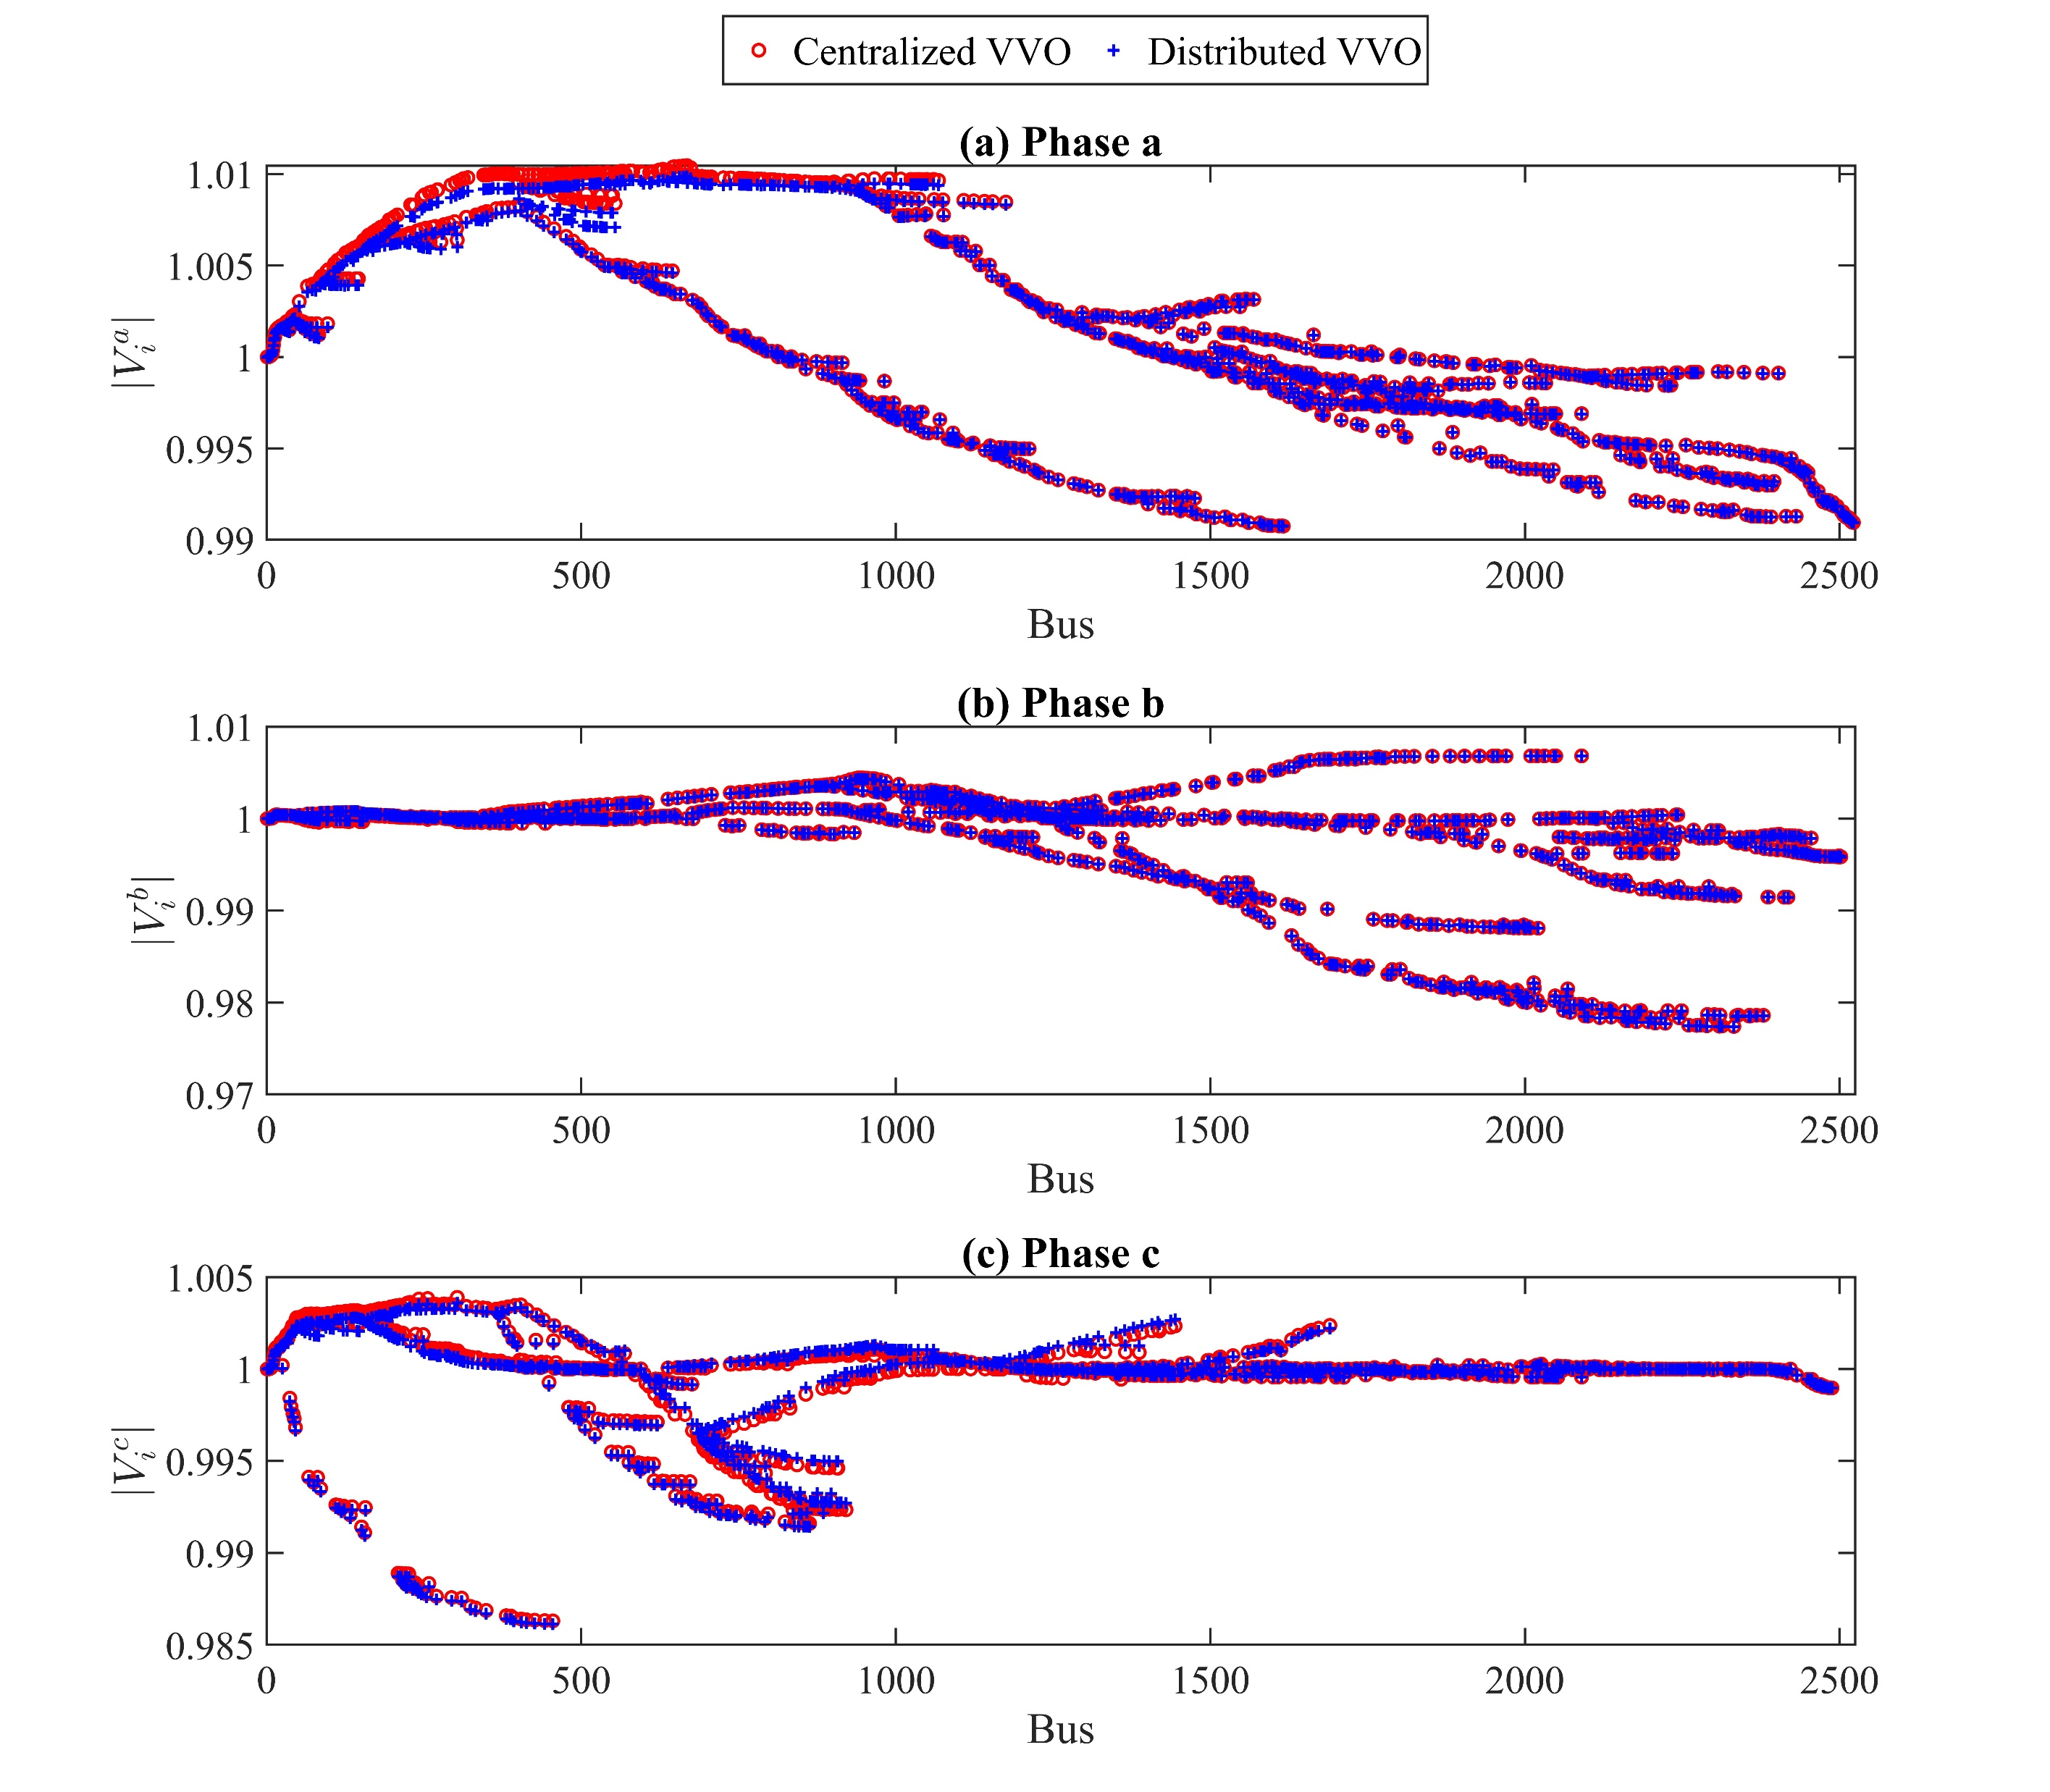

Slide 8
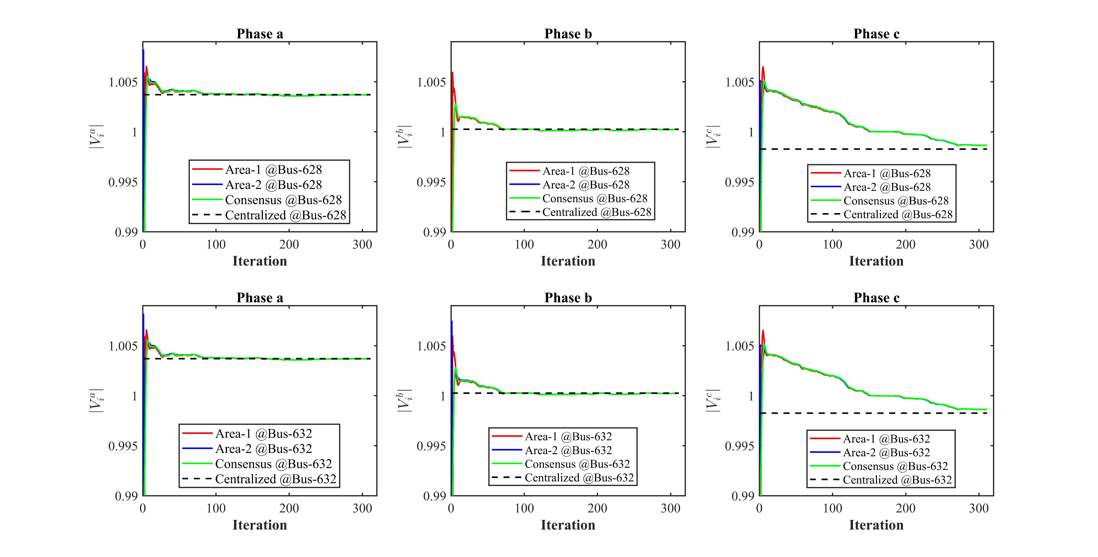

Slide 9
